Slide 1
Machine Learning- Regressions

Slide 2
Regression Modelling
In this section we’ll introduce the basics of regression modeling, including linear relationships, least squared error, simple and multiple regression and non-linear models
Topics To Cover:
Goals
Understand basic linear relationships and the concept of least squared errors
Explore the difference between simple (univariate) and multiple linear regression
Demonstrate how regression can be used to model linear or non-linear relationships
Linear Relationships
Least Squared Error
Univariate Linear Regression
Multiple Linear Regression
Non-Linear Regression

Slide 3
Linear Regression
Regression analysis is one of the most widely used methods for prediction.
Linear regression is probably the most fundamental machine learning method out there and a starting point for the advanced analytical learning path of every aspiring data scientist.
A linear regression is a linear approximation of a causal relationship between two or more variables.
Regression models are highly valuable, as they are one of the most common ways to make inferences and predictions.
Apart from this, regression analysis is also employed to determine and assess factors that affect a certain outcome in a meaningful way. As many other statistical techniques, regression models help us make predictions about the population based on sample data.

Slide 4
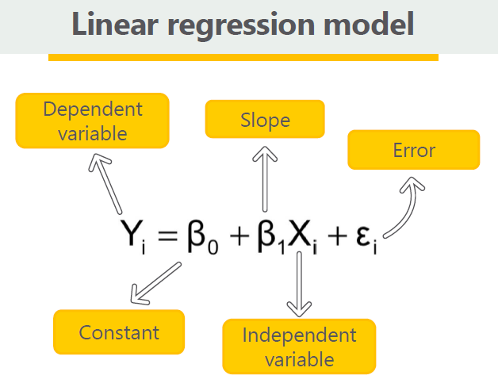
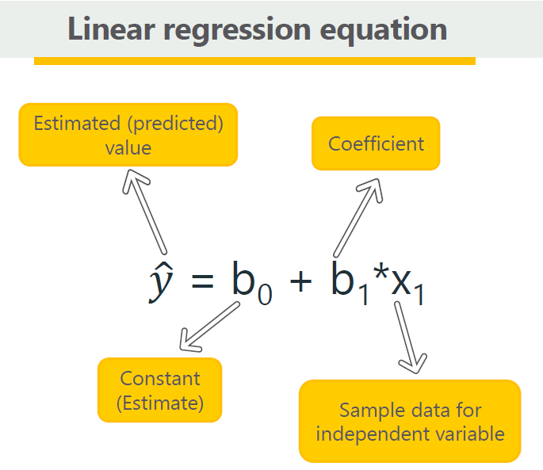

Slide 5
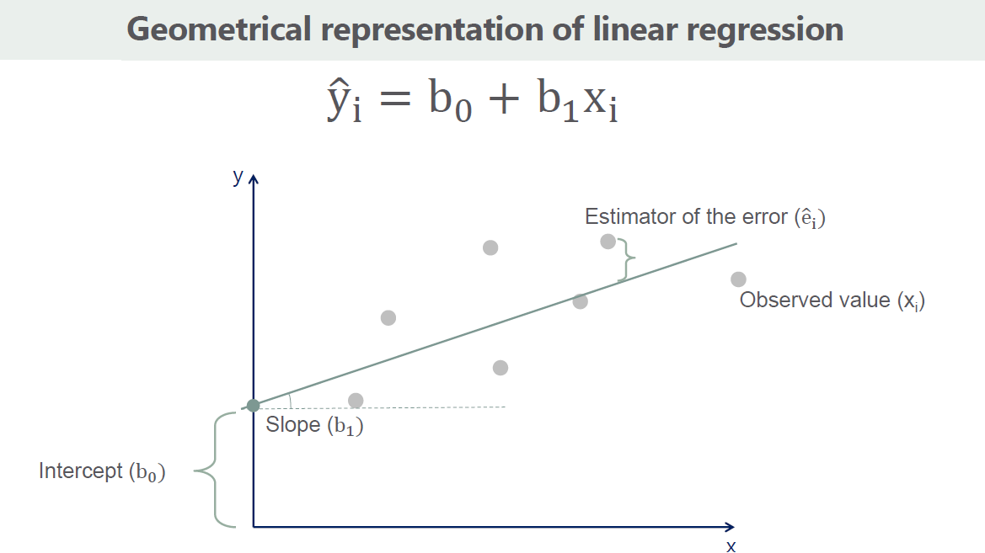

Slide 6


Simple Linear Regression Analysis
In this model, Y must have some causal dependency on X.
Y is the dependent variable which we are trying to predict based on X
X is independent variable or regressor
If X is years of education and Y is income, this equation tells us simply that with more years of education income will be higher.
However, if education years is 0 then we will have at least minimum income of
Error in estimation is represented as Epsilon which represents difference between observed income and the predicted income. On average across all observation error is 0.
This is Population Formula where we need to consider the whole data sets.
Statistics works with Sample data so in practice we will use linear regression:

Slide 7
An Example
X | Y | XY | X² | Y-hat | Y-Y-hat
1 | 4 | 4 | 1 | 4.2 | -0.2
2 | 6 | 12 | 4 | 5.7 | 0.3
3 | 7 | 21 | 9 | 7.2 | -0.2
4 | 9 | 36 | 16 | 8.7 | 0.3
5 | 10 | 50 | 25 | 10.2 | -0.2
6 | ?
Assume Linear Relationship : Y = mx + b
X – independent data points
Y – variable (actual observation)
Y-Hat is the estimated value of Y: Y-hat = mx + b -> m and b are unknown
Cost or Objective Function or Error e = y – y-hat = y – mx – b for all x and y

Slide 8












How to estimate m and b

Slide 9










Slide 10










Slide 11










Correlation coefficient
Is Regression good for all data set ?
Sometime regression may not give good and meaningful interpretation when data is spread out and not reflect strong relationship between variables (x,y).
To measure the goodness of regression few measures can be used. One of them in Correlation.

Slide 12
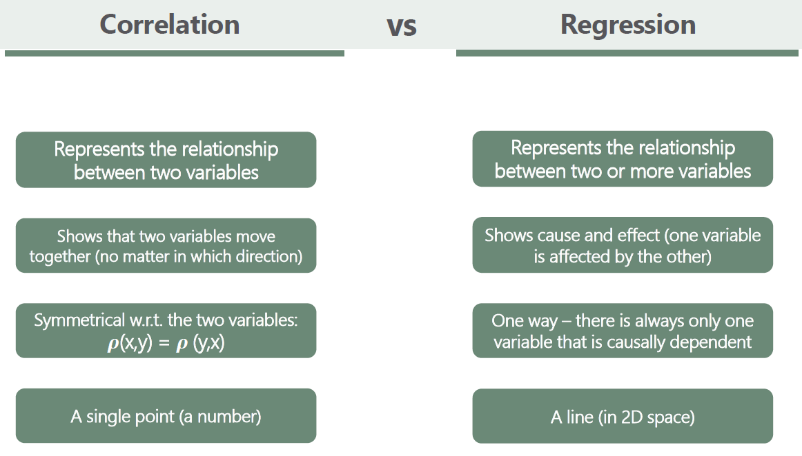

Slide 13





LINEAR RELATIONSHIPS
A linear relationship means that when you increase or decrease your X variable, your Y variable increases or decreases at a steady rate
If you plot a linear relationship over many X/Y values, it will look like a straight line
Mathematically, linear relationships can be described using the following equation:
Y-intercept
y = ⍺ + βx
X value
( x , y )
β
Y value
Slope (rise/run)
⍺
NOTE: Not all relationships are linear (more on that later!)
Common examples:
Taxi Mileage (X) and Total Fare (Y)
Units Sold (X) and Total Revenue (Y)
House Size (X) and House price (Y)

Slide 14
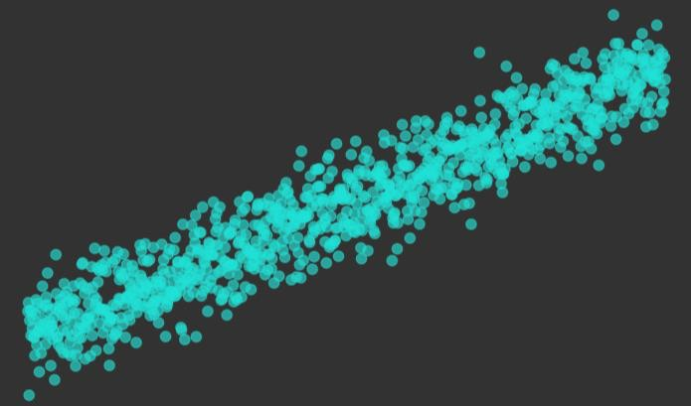
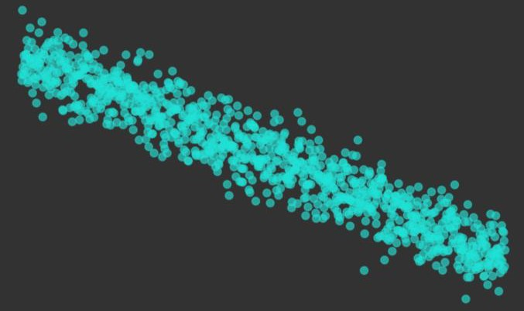
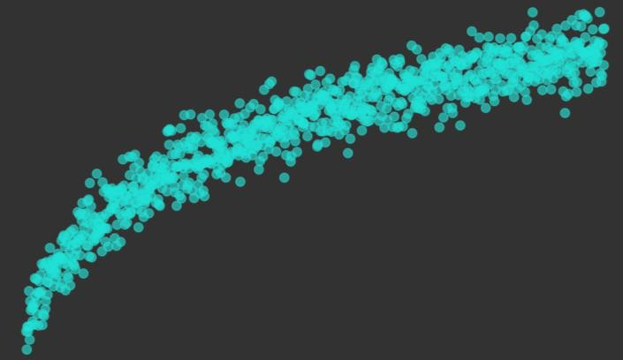

LINEAR RELATIONSHIPS
Positive Linear
Negative Linear
Non-Linear (logarithmic)
No Relationship
Sometimes there’s no relationship at all!

Slide 15
LINEAR RELATIONSHIPS
50
40
Consider a line that fits
every single point in the plot
This is known as a perfectly linear relationship
30
20
10
10
20
30
40
50
60
70
80
In this case you can simply calculate the exact value of Y for any given value of X (no Machine Learning needed, just simple math!)

Slide 16
LINEAR RELATIONSHIPS
50
40
In the real world, things aren’t quite so simple
When you add variance, it means that many different lines could potentially fit through the plot
30
20
10
10
20
30
40
50
60
70
80
To find the equation of the line with the best possible fit, we can use a technique known as least squared error or “least squares”

Slide 17
LEAST SQUARED ERROR
Least squared error is used to mathematically determine the line that best fits through a series of data points
Imagine drawing a line through a scatterplot, and measuring the distance between your line and each point (these distances are called errors, or residuals)
Now square each of those residuals, add them all up, and adjust your line until
you’ve minimized that sum; this is how least squares works!
Why “squared” error?
Squaring the residuals converts them into positive values, and prevents positive and negative distances from cancelling each other out (this helps the model optimize more efficiently, too)

Slide 18
LEAST SQUARED ERROR
y = 12 + 0.4x
50
X | Y (actual) | Y (line) | Error | Sq. Error
10 | 10 | 16 | 6 | 36
20 | 25 | 20 | -5 | 25
30 | 20 | 24 | 4 | 16
35 | 30 | 26 | -4 | 16
40 | 40 | 28 | -12 | 144
50 | 15 | 32 | 17 | 289
60 | 40 | 36 | -4 | 16
65 | 30 | 38 | 8 | 64
70 | 50 | 40 | -10 | 100
80 | 40 | 44 | 4 | 16
40
30
20
10
10
20
30
40
50
60
=
70
80
SUM OF SQUARED ERROR:
722
Plot a new line, and continue the process until you’ve found the line that minimizes the sum of squared error
This is where Machine Learning comes in; human trial-and-error is completely
impractical, but machines can find an optimal linear equation in seconds

Slide 19




UNIVARIATE LINEAR REGRESSION
Univariate (“simple”) linear regression is used for predicting a numerical output (DV) based on a single independent variable
Univariate linear regression is simply an extension of least squares; you use the linear equation that minimizes SSE to predict an output (Y) for any given input (X)
Coefficient/parameter (sensitivity of Y to X)
Dependent variable (DV)
This is just the equation of a line, plus an error term
y =⍺ + βx + 𝜀
Error/residual
Y-intercept Independent variable (IV)
Simple linear regression is rarely used on its own; think of it as a primer for understanding more complex topics like non-linear and multiple regression

Slide 20
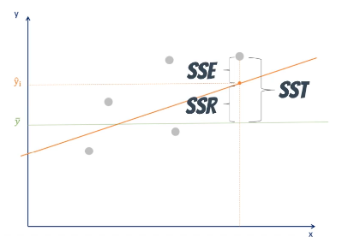
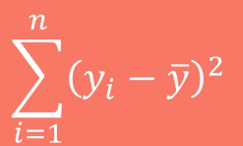
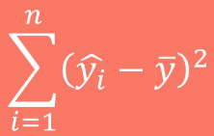
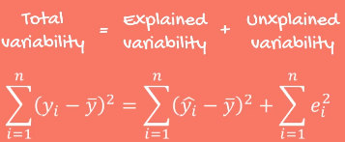
Variability
SST (TSS) – Sum of square Total
It measures Total Variability
SSR (ESS)– Sum of square difference between
Predicted and mean of
Dependent variable.
It measures how well we are align with the data
SSE (RSS)– Error is the difference between the
observed value and predicted value

Slide 21
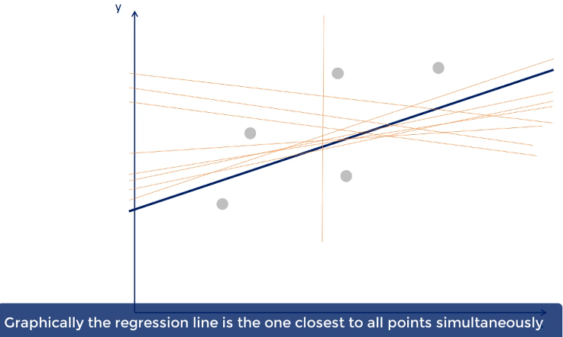
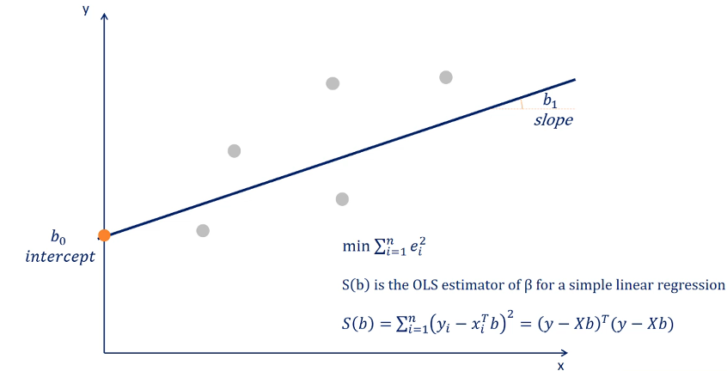
R Squared
R2 = SSR / SST
1- SSE/SST
It explains variability of data between 0 and 1
0 – Model explain none of the variability
1- Model explains all variability

Slide 22
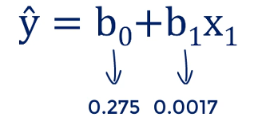
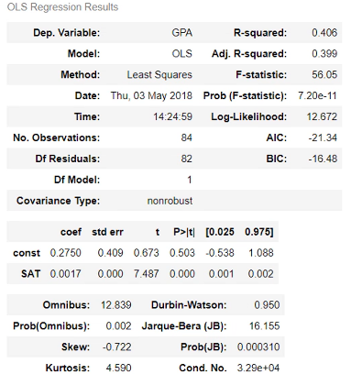


Stat summary Tables
So lower the standard error, better the estimate
T-statistics and P value tells us that there is a hypothesis. Null hypothesis is Coeff = 0.
The significance of a variable is explained by P-value. If P-value is below 0.05 means that variable is significant.

Slide 23
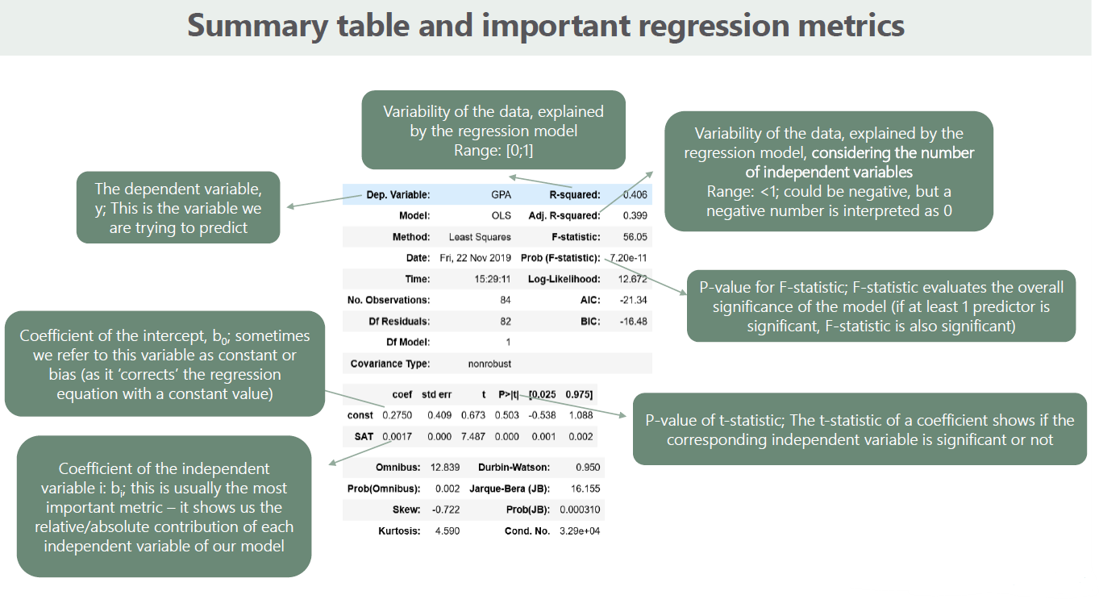

Slide 24
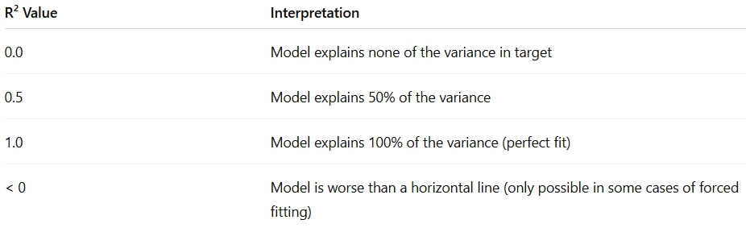




R Squared Explained
R-squared, also known as the coefficient of determination, is a statistical measure used to evaluate the performance of a regression model. It tells us how well the independent variable(s) explain the variation in the dependent variable.
High R² ⇒ model fits data well.
Low R² ⇒ model doesn’t capture much of the variation.
A high R² does not mean the model is good.
It may be overfitting.
Doesn’t indicate causality or correctness of predictors.
Adjusted R² is preferred when multiple predictors are involved, as it penalizes unnecessary variables

Slide 25










Linear regression explain with Algebra

Slide 26
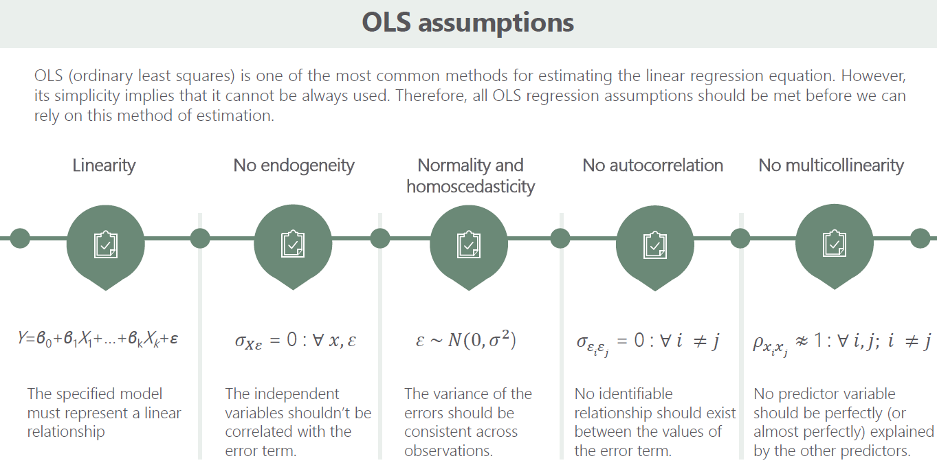

Slide 27
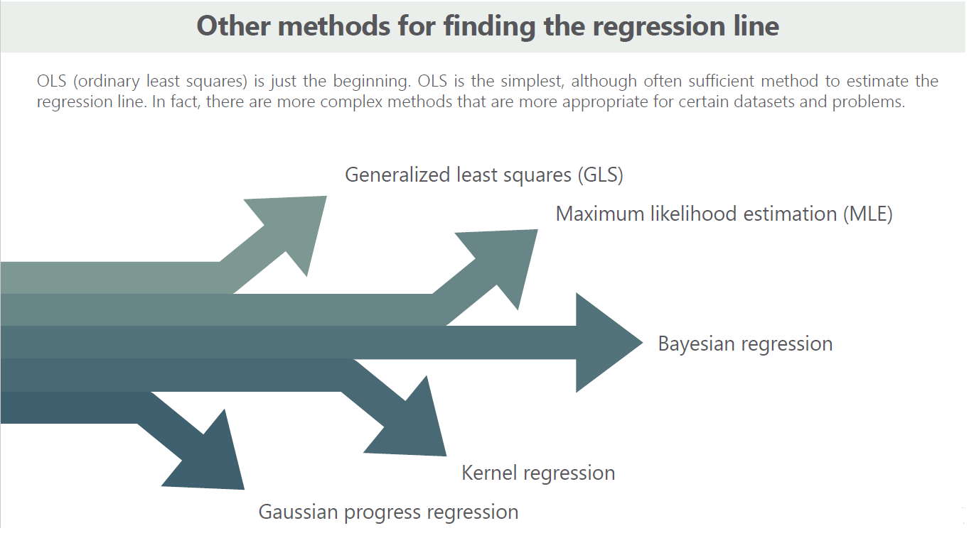

Slide 28


MULTIPLE LINEAR REGRESSION
Can we use more than one IV to predict the DV?
Multiple linear regression is used for predicting a numerical output (DV) based on multiple independent variables
In its simplest form, multiple linear regression is simply univariate linear regression with additional x variables:
DV
y =⍺ + β₁x₁ + β₂x₂ + β₃x₃ + … + β_{n}x_{n} + 𝜀
Error/ residual
Y-intercept
Instead of just 1 IV, we have a whole set of independent variables
(and associated coefficients/weights) to help explain our DV

Slide 29
Miles Per Litre | Horse Power | Weight
21 | 110 | 2.62
21 | 110 | 2.875
22.8 | 93 | 2.32
21.4 | 110 | 3.215
18.7 | 175 | 3.44
18.1 | 105 | 3.46
14.3 | 245 | 3.57
24.4 | 62 | 3.19
22.8 | 95 | 3.15
19.2 | 123 | 3.44
17.8 | 123 | 3.44
16.4 | 180 | 4.07
17.3 | 180 | 3.73
15.2 | 180 | 3.78
10.4 | 205 | 5.25
10.4 | 215 | 5.424
14.7 | 230 | 5.345
32.4 | 66 | 2.2

Slide 30
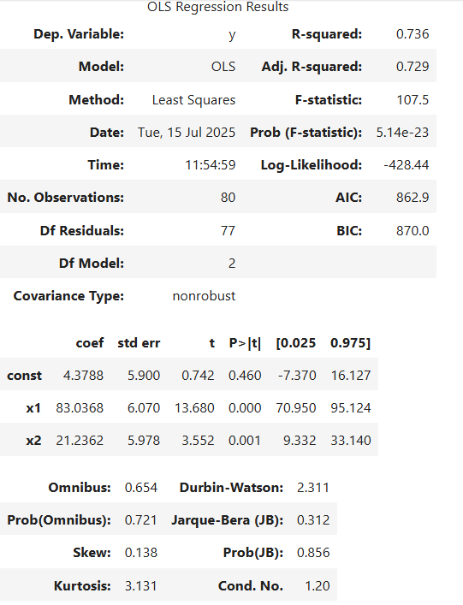
Obs | feature1 | feature2 | target
0 | 0.629948 | 0.977276 | y
1 | 0.315627 | -0.671716 | y
2 | -0.190359 | 0.569201 | y
3 | 0.678495 | -0.642086 | y
4 | -0.709805 | 0.473664 | y

